Slide 1
Arhitecturi Paralele Building a Distributed Database
Prof. Florin Pop
As. Drd. Ing. Cristian Chilipirea
cristian.chilipirea@cs.pub.ro
Elemente preluate din cursul Prof. Ciprian Dobre

Slide 3
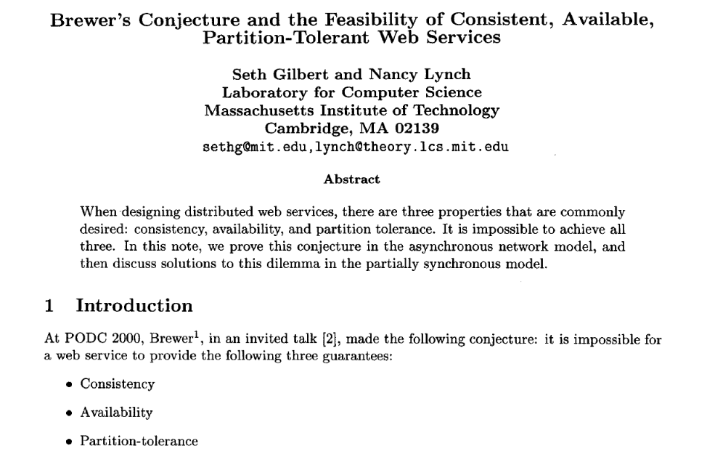
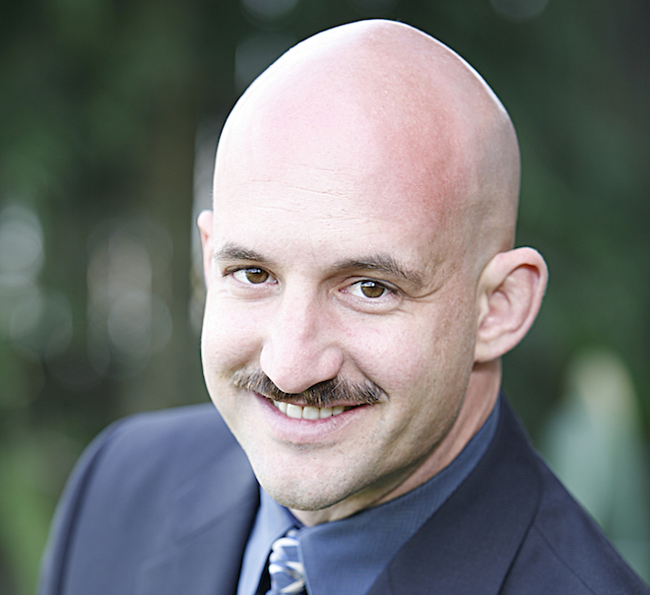
CAP Theorem

Slide 5
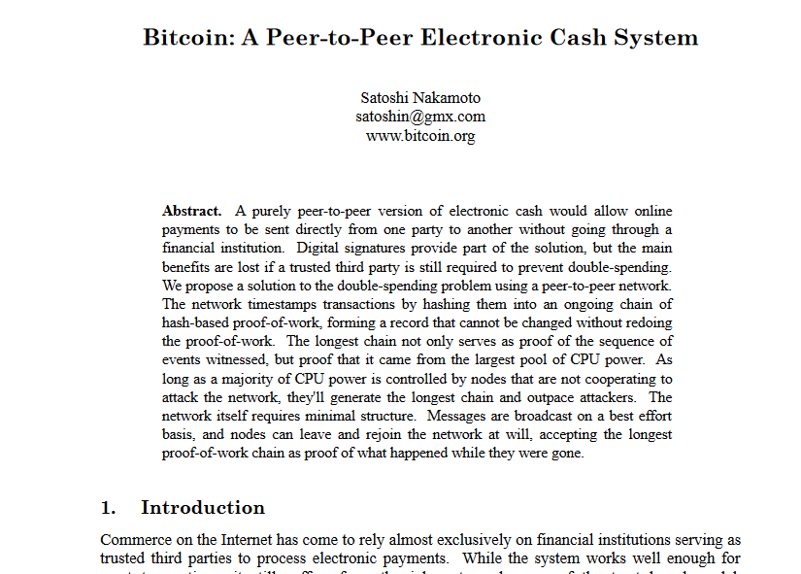

Bitcoin and Blockchain

Slide 6
Bitcoin and Blockchain
Cheats on the CAP theorem
Eventual consistency
Availability
Partition-tolerance (But short)

Slide 7
Proof of Work

Slide 8
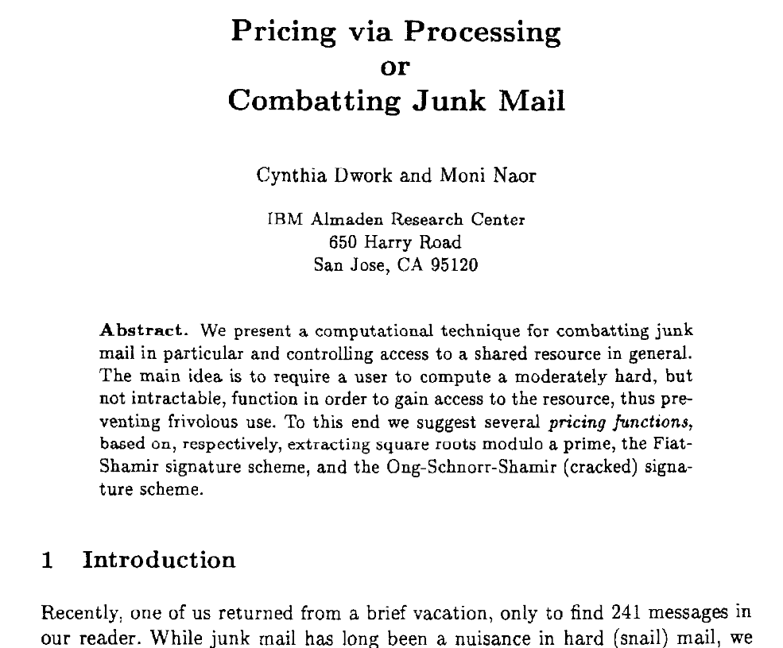
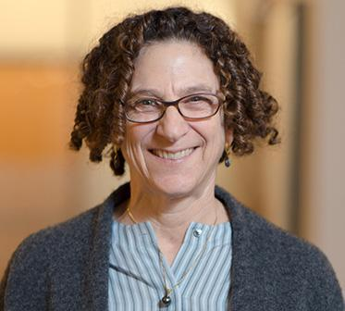
Proof of Work

Slide 9
Proof of Work
y = f(x)
f() este extrem de lentă computațional
x = g(y)
g() este extrem de rapidă computațional

Slide 10

Proof of Work
x; Cât este f(x)?

Slide 11
Proof of Work
Processing!!!

Slide 12
Proof of Work
Processing!!!

Slide 13
Proof of Work
y

Slide 14
Proof of Work
g(y) == x?
DA - știu că a muncit
NU – încearcă să trișeze

Slide 15
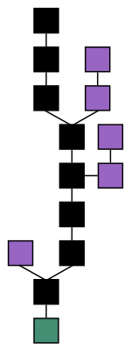
Blockchain

Slide 16
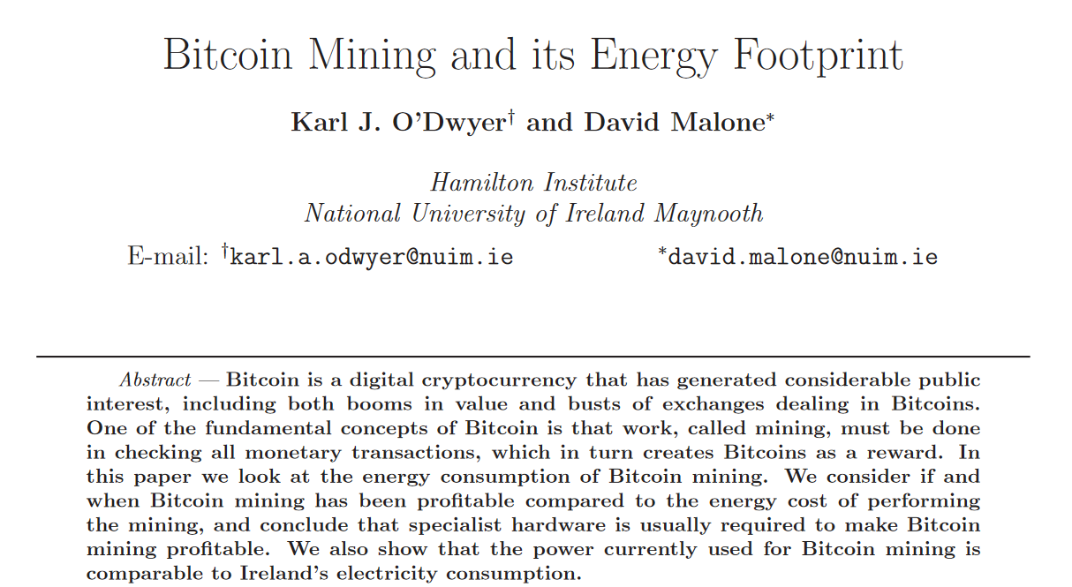
Bitcoin energy consmption

Slide 17
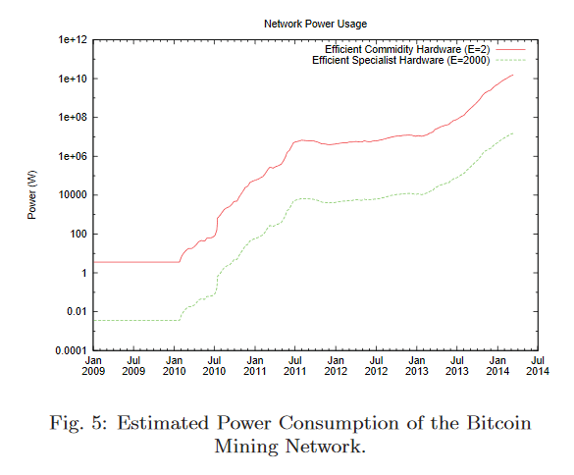
Bitcoin energy consmption

Slide 19
Transactions

Slide 20
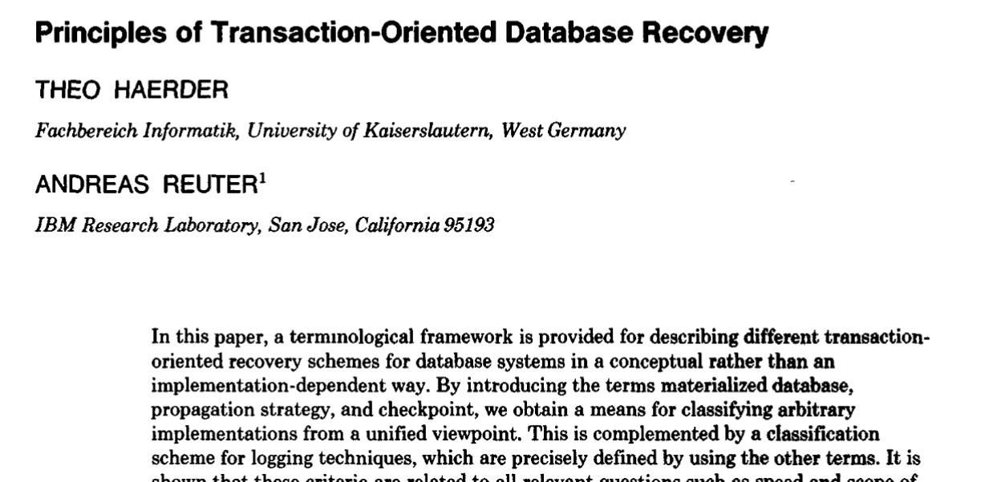


ACID
Notes:
Andreas Reuter
Theo Härder

Slide 22
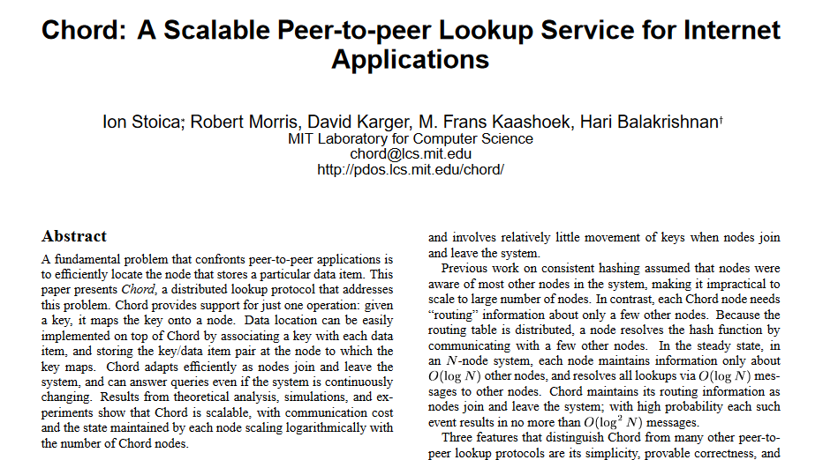
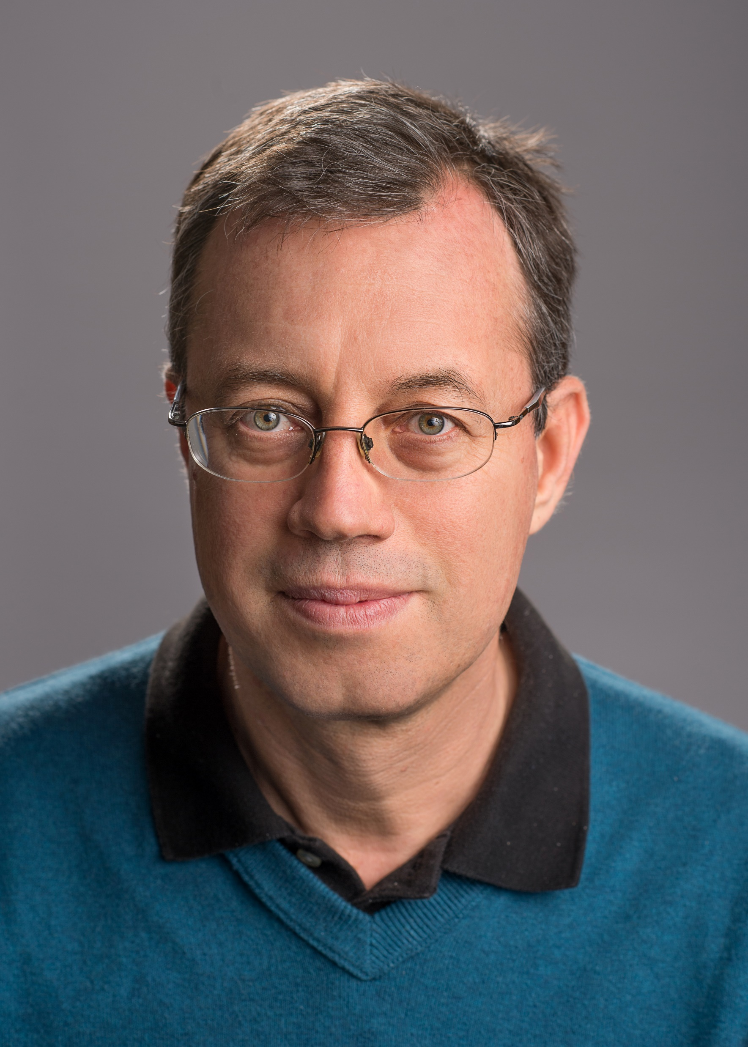
Distributed Hash Table Chord

Slide 23
Amazon DynamoDB

Slide 24
Caching

Slide 25
Peer to Peer

Slide 26
Geolocation

Slide 27
Content Delivery Networks

Slide 28
Load Balancing

Slide 29
Cloud Computing

Slide 30
Spark?

